Slide 1

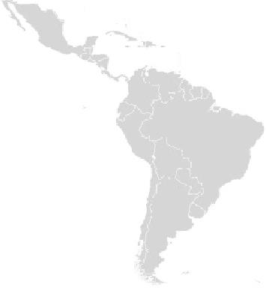
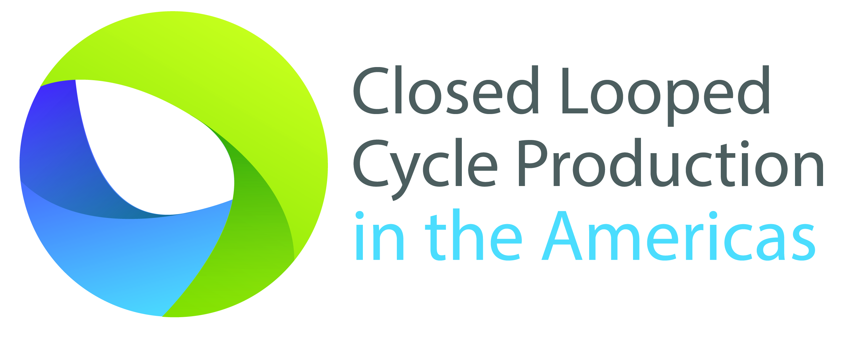
Trinidad and Tobago
Panama
Colombia
Ecuador
Facilitating the transition towards a circular economy
Organization of American States, Washington DC
Closed Looped Cycle Production in the Americas (CLCPA)
Updated: November 17, 2014
Notes:
What is Closed Lopped Cycle Production?
This initiative is focused on promoting, introducing and applying the concept of “Closed Looped Cycle Production” to the productive sector of nations in the Americas as a key solution to help mitigate climate change through sustainable and eco-effective production. This implies the development of industrial processes or of manufacturing in which materials utilized in a product become valuable nutrients upon reaching the end of their useful life. This may incentivize nations to achieve closed looped cycle consumption patterns or circular economies that will contribute to reducing dependency on continuous extraction of increasingly scarce commodities, improving energy efficiency as well as increase environmental performance due to the reduction of GHG emissions, solid waste and waste water generation among other environmental impacts while simultaneously improving the productivity and competitiveness of businesses.

Slide 2
Agenda
Global Trends
Waste Management
Linear Economy vs. Circular Economy
Closed Looped Cycle Program-T&T Project
Closed Looped Cycle Production in the Americas (CLCPA)

Slide 3
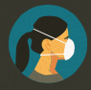


Global Trends
Enviroment
CO2 concentration beyond the safe upper limit.
Scare of raw material- price variability.
Social
The World is getting crowded...
Rapid and unmanaged urbanization...
Economic
Consumption beyond limits.
Externalities are still external.
Urban air quality is deteriorating
Waste is today generated faster than any other environmental pollutant.
The global middle class is growing .
Higher prices of goods.
Lineal Economy Dominates
Closed Looped Cycle Production in the Americas (CLCPA)
http://www.dnvgl.com

Slide 4
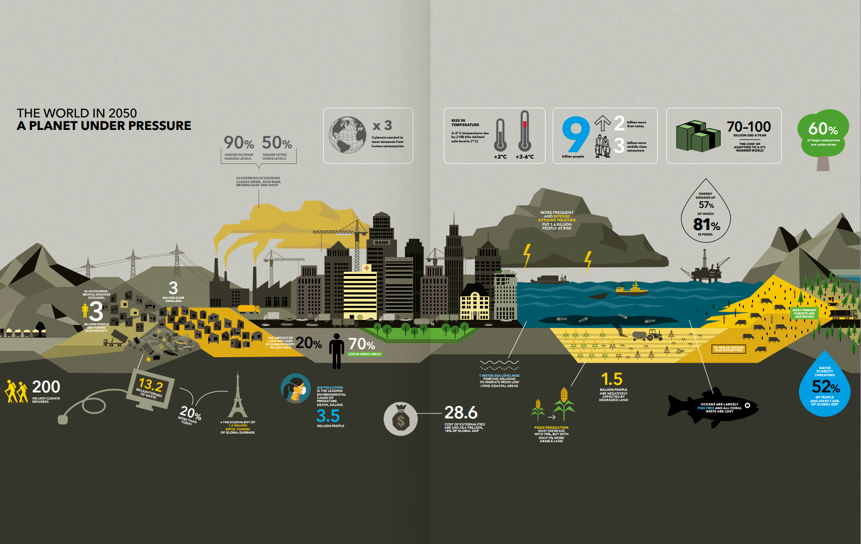
The World in 2050
Closed Looped Cycle Production in the Americas (CLCPA)
http://www.dnvgl.com

Slide 5
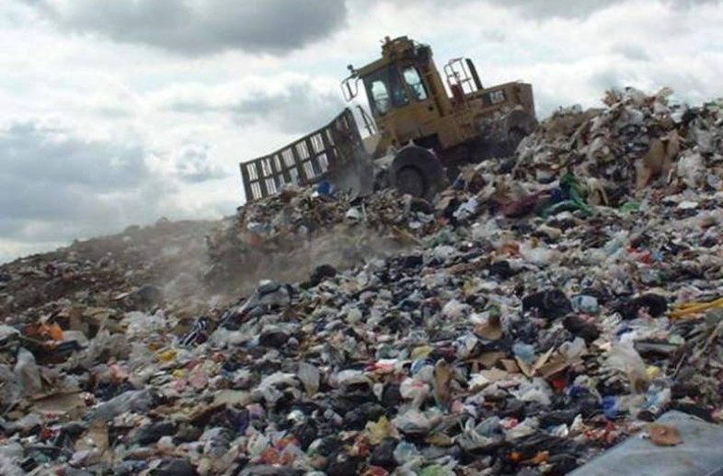
Waste Management.
Closed Looped Cycle Production in the Americas (CLCPA)
..

Slide 6
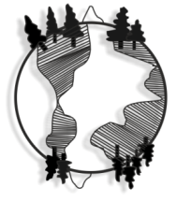
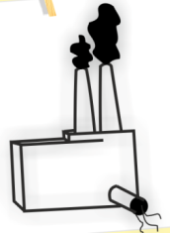
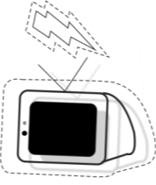

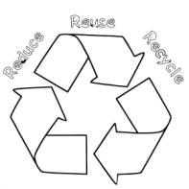
Practical Approaches to Waste Management.
➔
➔
➔
➔
Raw Materials
Product Manufacturing
Reuse
Recycle
Use of Products
Public education
Pricing Mechanisms
(such as product charges) to stimulate consumer behavior to reduce waste generation and increase recycling;
To inform people about their options to reduce waste generation and increase recycling and composting;
User charges tied to the quantity of waste disposed
Consumers separating recyclables paying a lower fee for waste disposal;
Preferential procurement policies and pricing
To stimulate demand for products made with recycled post-consumer waste.
Closed Looped Cycle Production in the Americas (CLCPA)
..

Slide 7
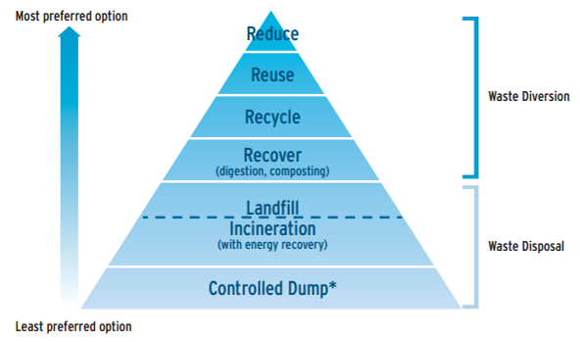
Waste Hierarchy
Rethink!!
We cannot solve our problems with the same thinking we used when we created them (Albert Einstein)
Closed Looped Cycle Production in the Americas (CLCPA)
..

Slide 8
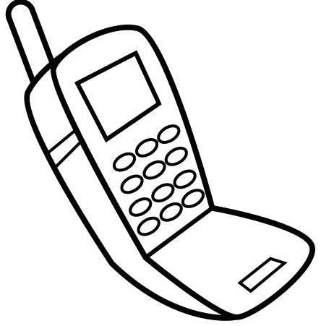
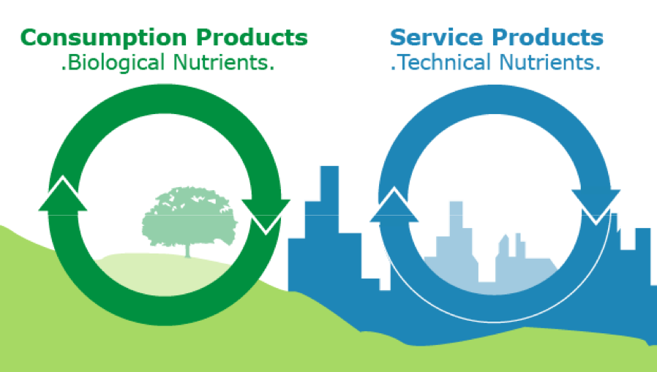
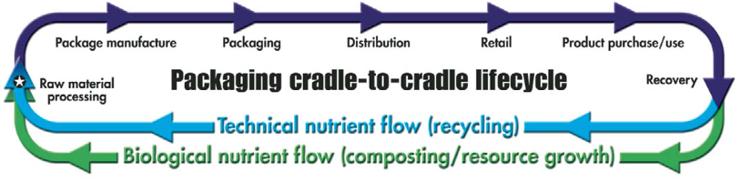
Cradle to Grave vs. Cradle to Cradle
TAKE
MAKE
DISPOSE
Waste = Food
Use Current Solar Income
Celebrate Diversity
Closed Looped Cycle Production in the Americas (CLCPA)

Slide 9
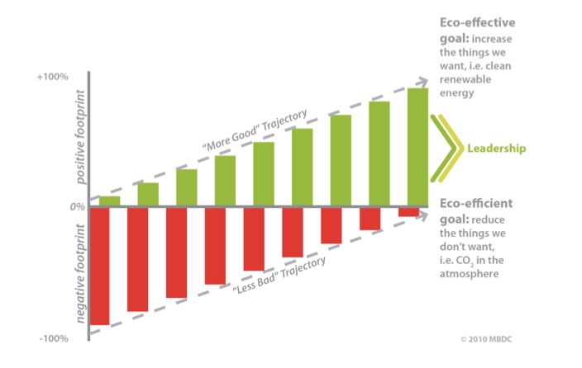
Eco-efficient vs. Eco-effective
Sustainability
The ability to meet the needs of the present without compromising the ability of future generations to meet their own needs.
Closed Looped Cycle Production in the Americas (CLCPA)

Slide 10
Eco-Efficient vs. Eco-Effective
The traditional way: Eco-Efficient Packaging | The C2C way: Eco-Effective Packaging
Minimize the amount of packaging materials to reduce impact on environment. | Use as much packaging as is desired to protect and differentiate the product because that package will become a biological or technical nutrient after its first use.
Discourage littering because materials don’t break down for decades; and if they do, toxics additives can enter the environment. | Discarded biodegradable packaging that incorporates soil nutrients would actually benefit the environment, not harm it.
Consumer is left with the liability of packaging disposal after product is consumed. | Consumer no longer has disposal liability because package will become a technical or biological nutrient after its first use. Customer is left with a positive impression of the product and the manufacturer.
Recycled content packaging can result in reduced performance and attractiveness. | By positively selecting the right additives and inks, packaging can be cheaper to recycle in a true, 100% closed loop process with no loss in performance.
Recycling often requires consumers to distinguish among unfamiliar types of materials, such as various types of plastics. | Consumers pitch all recyclables in another, letting modern sortation technology do the work.
Deposits may be mandated by law | Packagers can create their own deposit systems to recover expensive, desirable packages.
Packaging materials must be as cheap as possible, often leading to multilayer composites or laminates that are difficult or impossible to reuse or recycle. | Returnable packaging reduces or eliminates the need to create hybrids that don’t really disassemble into technical or biological nutrients.
Closed Looped Cycle Production in the Americas (CLCPA)
www.packworld.com

Slide 11
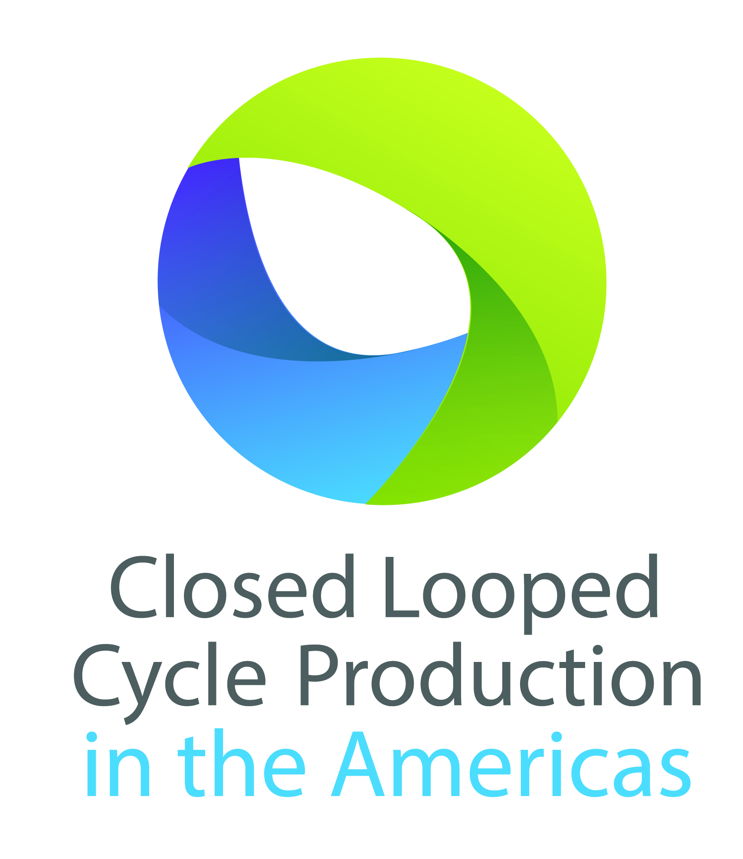
CLCPA Program
Facilitating the transition towards a circular economy
Program Objective:
Introduce and showcase the viability and applicability of Closed Looped Cycle Production design and manufacturing methodologies in the production sector of nations in the Americas as an innovative business development tool to mainly improve energy efficiency and environmental performance in the industrial sector and to increase the productivity, competitiveness and sustainability of businesses, and facilitate the transition toward circular economies throughout the region.
Awareness Raising
Increase awareness, knowledge, and collaboration among stakeholders (government, national enterprises, National Cleaner Production Centers (NCPC), Small Business Development Centers (SBDC) or chambers of commerce, etc.) about Closed Looped Cycle Production.
Analysis and Policy Advice
Prepare and present position papers to stakeholders to facilitate high-level policy dialogue on economic and environmental benefits of sustainable design and closed-looped cycle production methods necessary for incentivizing and supporting MSMEs adoption of Closed Loop Cycle Production.
Promote Application
Promote the application or adoption of Closed Looped Cycle Production methods (incl. Cradle-to-cradle, Cleaner Production, Sustainable Materials Management, or similar certifications and methods) by companies, in particular SMEs in participating countries
Closed Looped Cycle Production in the Americas (CLCPA)

Slide 12




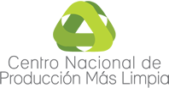



Closed Looped Cycle Production in the Americas timeline
Ministry of Commerce, Industry and Tourism
Ministry of Commerce and Industry
Ministry of Planning and Sustainable Development
Request from the Ministry of Coordination of Production, Employment and Competitiveness
2009
2010
2011
2012
2013
2014
2015
The initiative was conceived
National Closed Looped Cycle Production Program
First Cradle-to-Cradle basic certified product in LAC
Cleaner Production Center for Ecuador
Inclusion of dedicated text in the National Development Plan
Sustainable Productive Development towards a Circular Economy in Colombia
Development of Panama Green Label
Finding a sustainable alternative packaging to replace the Styrofoam containers
* Over $1.3 million invested
Closed Looped Cycle Production in the Americas (CLCPA)

Slide 13
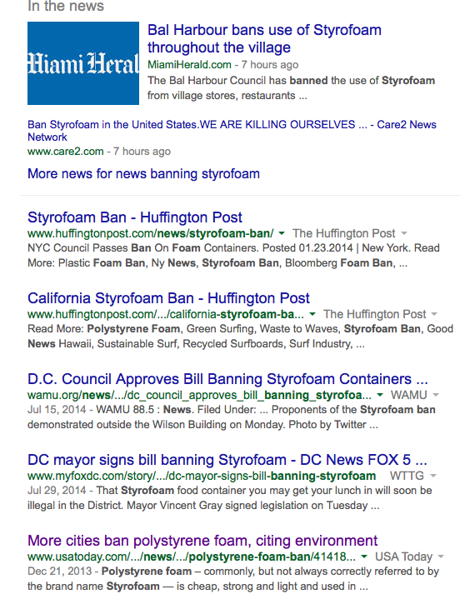
Styrofoam Facts
Made from Pretroleum
not biodegradable /not recycled
Takes up more space in landfills
useful life of minutes or hours
Contains Styrene and Benzene
Polystyrene recycling, if, and when it is carried out properly, is not "closed loop"
Closed Looped Cycle Production in the Americas (CLCPA)
Isites.harvard.edu
Notes:
Polystyrene is a petroleum-based plastic made from the styrene monomer
Styrofoam can generate the most deadly toxins ever studied like XX
Workers are exposed to the polystyrene and consumers.
Plastics are manufactured from oil and gas. These are not biodegradable material hence they need to be disposed in landfills, which then for many years pollute ground water.
Polystyrene (PS) require large landfill for their disposal, at the same time they should be well conserved against being blown all over by the wind.
In initial preliminary analysis of plastic wastes, the author found that polystyrene could be recycled and used as engineering material for different purposes. Secondly, the author found that the large volume of polystyrene can be reduced for easy disposal.
Polystyrene is not widely recycled and has become pervasive in the marine environment. carried through storm drains to the ocean.
It breaks down into small indigestible pellets that birds and marine mammals often fatally mistake for food.
The International Agency for Research on Cancer has determined that styrene is a possible human carcinogen and it has been listed as listed as a possible carcinogen by the National Institutes of Health's National Toxicology Program.
Styrene is classified as a possible human carcinogen by the EPA and by the International Agency for Research on Cancer (IARC).
The National Bureau of Standards Center for Fire Research identified 57 chemical byproducts released during the combustion of polystyrene foam. The process of making polystyrene pollutes the air and creates large amounts of liquid and solid waste.
Toxic chemicals leach out of these products into the food that they contain (especially when heated in a microwave). These chemicals threaten human health and reproductive systems.
These products are made with petroleum, a non-sustainable and heavily polluting resource.
large quantities of it can be found in the Great Pacific Garbage Patch.

Slide 14
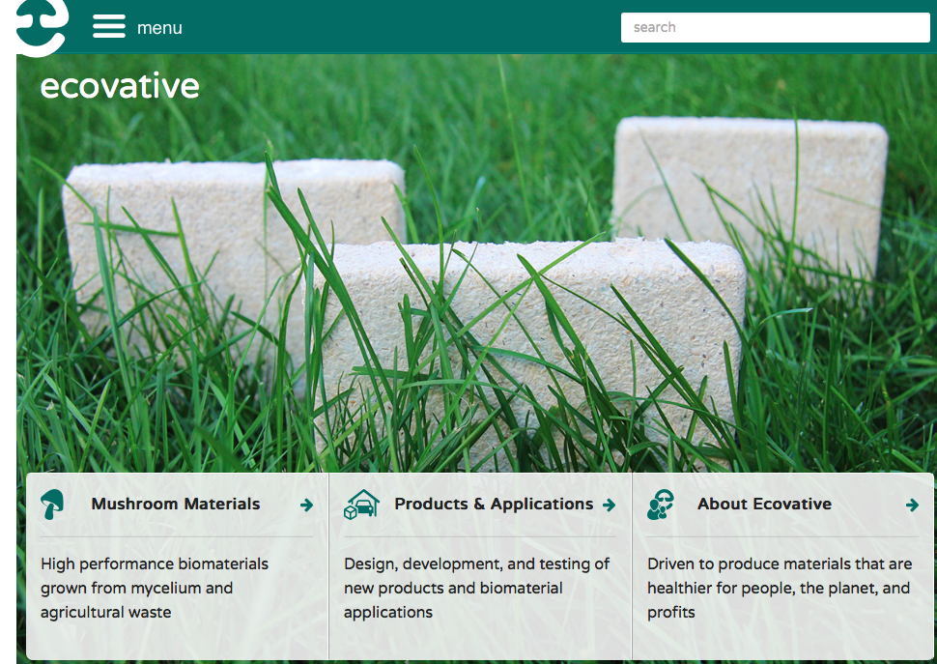
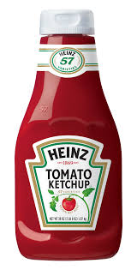
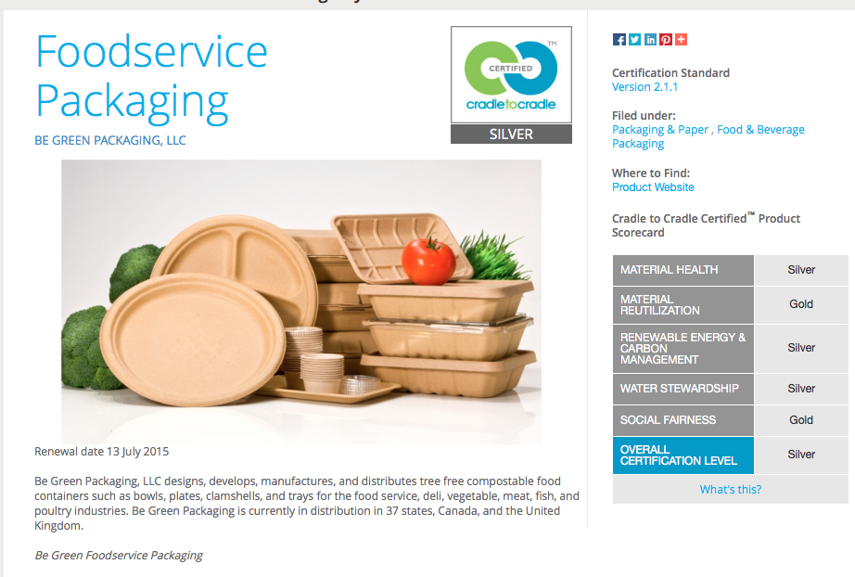
Biopolymer Revolution
Closed Looped Cycle Production in the Americas (CLCPA)
.
Notes:
The good news is that the current Biopolymer revolution (biodegradable polymers) is charting a path for producing environmentally friendly packaging material to replace those peanuts. Corn based and other seeds known collectively as soapstock waste lead the way. Some are already available as replacements. Perhaps the problematic recycling situation will be solved by replacing the product.
Polystyrene recycling is not "closed loop" - collected polystyrene cups are not remanufactured into cups, but into other products, such as packing filler and cafeteria trays. This means that more resources will have to be used, and more pollution created, to produce more polystyrene cups.
Coca-Cola (nyse: KO) announced plans today to invest $24 million, along with ECO Plastics Ltd. (which will contribute about $5 million of that) to build a new, plastic bottle recycling facility in Lincolnshire, England. In recent weeks, the company also struck a landmark deal to sell its 30 percent plant-based plastic to Heinz, which will begin to use it in ketchup and condiments packaging in June.

Slide 15

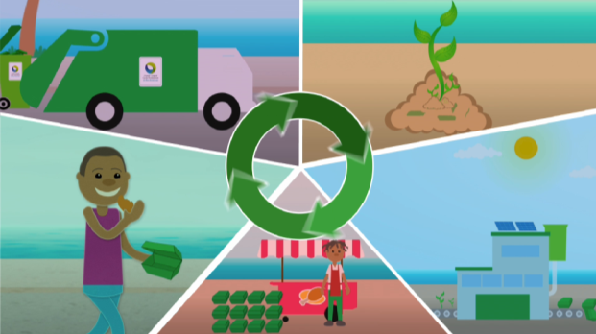
CLCPA Project in Trinidad and Tobago (ongoing)
Finding a sustainable alternative packaging to replace the Styrofoam containers
Within the manufacturing sector the Printing and Packaging and the Food and Beverages are identified as the sub-sectors with the greatest potential for further growth and that warrant the Government’s attention and assistance from the CLCPA Program for their sustainable development.
Closed Looped Cycle Production in the Americas (CLCPA)
Notes:
The non-energy related sectors have been prioritized by the Government of Trinidad and Tobago for further economic diversification and strategic development. Within the manufacturing sector the Printing and Packaging and the Food and Beverages are identified as the sub-sectors with the greatest potential for further growth and that warrant the Government’s attention and assistance from the CLCPA Program for their sustainable development.
When assessing the general performance indicators of the sectors of the economy, the waste production indicator, as one of the environmental indicators of the industrial sector, shows that more than 1,300 tons of waste reaches the landfill sites of Trinidad and Tobago every day. The Styrofoam among other materials is the most common type of material disposed by the Domestic and Industrial sectors. Therefore, the petition of the Ministry of Planning and Sustainable Development to focus the project of the CLCP in Trinidad and Tobago on among other finding a sustainable material to replace the Styrofoam and overcome the negative environmental impact of the high usage of these materials on food containers.
The development of the project to find a sustainable material to replace the Styrofoam as a highly used material within the Printing and Packaging Industry of Trinidad and Tobago

Slide 16
Contact information
ing. Kevin de Cuba, MSc.
Program Manager
Closed Looped Cycle Production in the Americas
T: +1-202-370-4601
E: kdecuba@oas.org
Director DDS
Cletus Springer
cspringer@oas.org
CLCP Team
Ruben Contreras
rcontreras@oas.org
Bibiana Serna
bserna@oas.org
Andrea Herrera
jaherrera@oas.org
Charlene Solozano
csolozano@oas.org
Rosy Arbieto
rarbieto@oas.org
Walter Araya
Walter_araya@hotmail.com
Section of Sustainabe Energía
Deparment of Sustainable Development - DDS
Executive Secretariat for Integral Development - SEDI
Organization of American States
1889 F St. N.W. Washington, D.C. 20006, USA
www.oas.org/dsd
Closed Looped Cycle Production in the Americas (CLCPA)

Slide 17
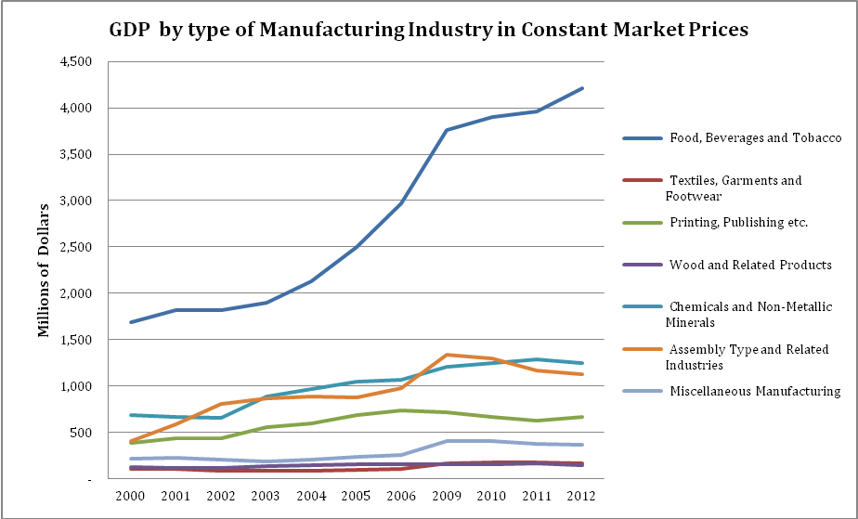
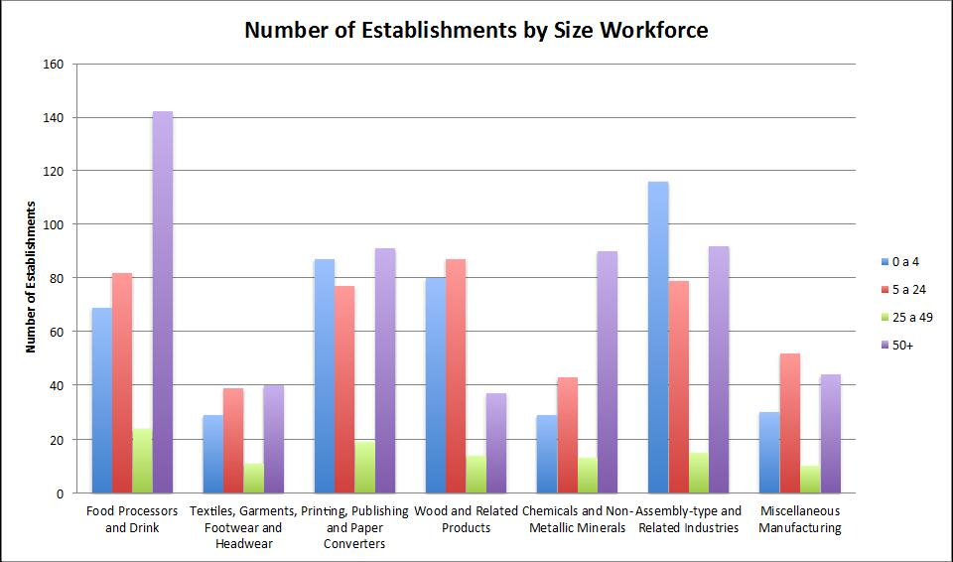
T&T Local Context
Waste generation per capital in T&T @2 kg.
Characterization 2012: Paper and paper board 28%, Plastics 22.2% and Textil: 17%
Food and Beverage (F&B) and Printing and Packaging- (P&P) strategic sectors.
P&P industry -leader in the CARICOM region.
P&P linkage P&F
Styrofoam commonly used for food containers.
The food and drink industry is expected to grow by almost $43 billion combined by 2016.
Political will to promote innovative packaging utilizing non traditional packaging and natural materials.
Cost of waste handling in T&T ranged from US$ 45.57 to US$ 63.83 per metric ton. (2000- 2004)
Closed Looped Cycle Production in the Americas (CLCPA)
http://www.dnvgl.com
Notes:
Economic diversification; Food and Beverage and the Printing and Packaging were defined as strategic sector.
The printing and packaging sub-sector has had a significant development since 1970, when the government instituted an import substitution strategy aimed at replacing foreign imports with domestic production.
It is one of the largest export sectors outside oil and gas, actually the industry is considered leader in the CARICOM region.
It has a very important linkage with the food and beverage sub-sector; the biggest contributor to the GDP within the manufacturing industry. Image.
The government has prioritized the sub-sector due to its competitive advantages.
Within this industry, the Styrofoam is the most common material used for food containers in T&T.
The Government of the Republic of Trinidad and Tobago signed a cooperation agreement with the Organization of American States (OAS) to implement a project aimed at introducing the use of biodegradable packaging materials. The agreement was signed in the framework of the VIII Americas Competitiveness Forum which was held in Port-of-Spain, Trinidad and Tobago from October 8th to 10th 2014.
the food and drink industry the industry is expected to grow by almost $43 billion combined by 2016.
Tang urged the audience of manufacturers to be innovative in your packaging and promotion to compete on an international level and to survive, the competition is not here but out there.
"Tobago already has a competitive advantage which entails innovative products, cheap energy, a huge non-resident Caribbean market, low labour cost, Caribbean branding potential, varied indigenous agro resources, an industrialised base and creative people. All that is needed is for you to ‘think out of the box’ to create market opportunities for exports with innovative packaging utilizing non-traditional packaging and natural materials."
In 2012 the industry contributed 0.7 annually to the GDP
The government is promoting farming
--------------------------------
Economic diversification; Food and Beverage and the Printing and Packaging were defined as strategic sector.
The printing and packaging sub-sector has had a significant development since 1970, when the government instituted an import substitution strategy aimed at replacing foreign imports with domestic production.
It is one of the largest export sectors outside oil and gas, actually the industry is considered leader in the CARICOM region.
It has a very important linkage with the food and beverage sub-sector; the biggest contributor to the GDP within the manufacturing industry. Image.
The government has prioritized the sub-sector due to its competitive advantages.
Within this industry, the Styrofoam is the most common material used for food containers in T&T.
The Government of the Republic of Trinidad and Tobago signed a cooperation agreement with the Organization of American States (OAS) to implement a project aimed at introducing the use of biodegradable packaging materials. The agreement was signed in the framework of the VIII Americas Competitiveness Forum which was held in Port-of-Spain, Trinidad and Tobago from October 8th to 10th 2014.
the food and drink industry the industry is expected to grow by almost $43 billion combined by 2016.
Tang urged the audience of manufacturers to be innovative in your packaging and promotion to compete on an international level and to survive, the competition is not here but out there.
"Tobago already has a competitive advantage which entails innovative products, cheap energy, a huge non-resident Caribbean market, low labour cost, Caribbean branding potential, varied indigenous agro resources, an industrialised base and creative people. All that is needed is for you to ‘think out of the box’ to create market opportunities for exports with innovative packaging utilizing non-traditional packaging and natural materials."
In 2012 the industry contributed 0.7 annually to the GDP
The government is promoting farming

Slide 18
